Slide 1

CHAPTER 9
COUNTING AND
PROBABILITY
Copyright © Cengage Learning. All rights reserved.

Slide 2
SECTION 9.3
Counting Elements of Disjoint Sets: The Addition Rule
Copyright © Cengage Learning. All rights reserved.

Slide 3
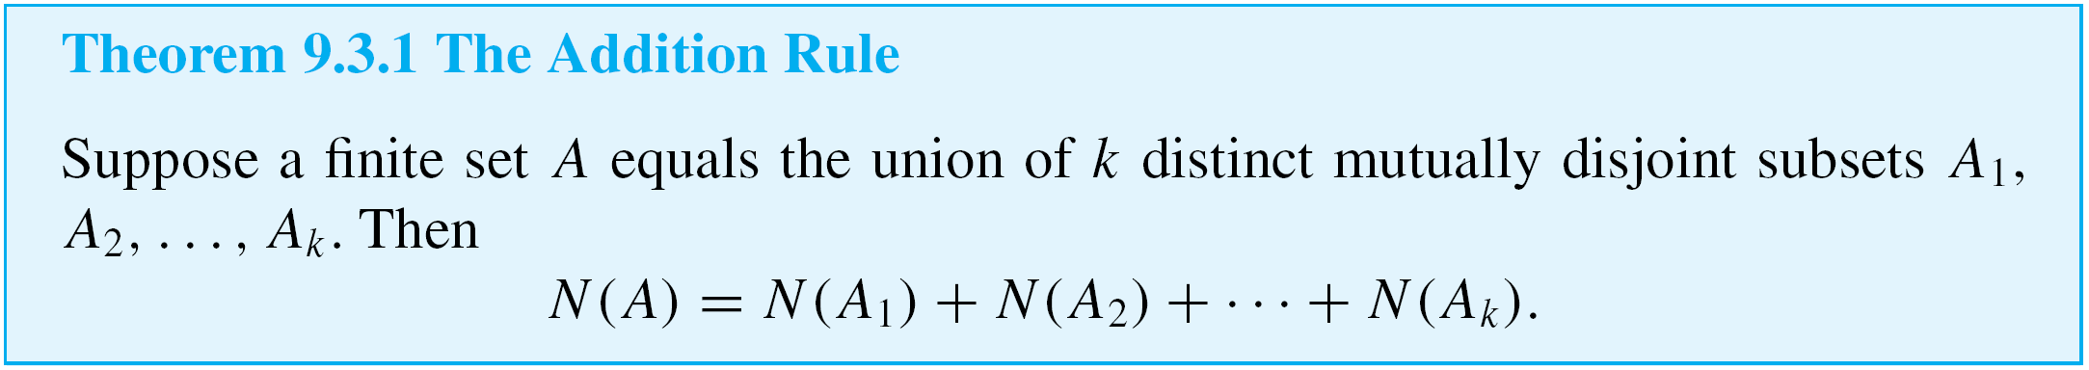
Counting Elements of Disjoint Sets: The Addition Rule
The basic rule underlying the calculation of the number of elements in a union or difference or intersection is the addition rule.
This rule states that the number of elements in a union of mutually disjoint finite sets equals the sum of the number of elements in each of the component sets.

Slide 4
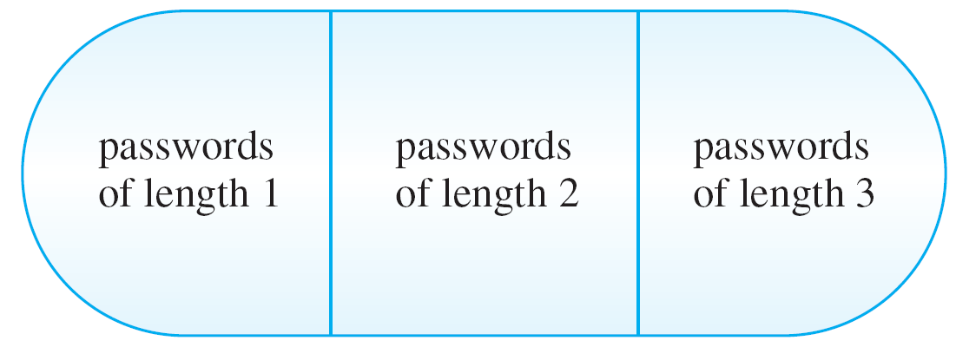
Example 1 – Counting Passwords with Three or Fewer Letters
A computer access password consists of from one to three letters chosen from the 26 in the alphabet with repetitions allowed. How many different passwords are possible?
Solution:
The set of all passwords can be partitioned into subsets
consisting of those of length 1, those of length 2, and those of length 3 as shown in Figure 9.3.1.
Set of All Passwords of Length ≤ 3
Figure 9.3.1

Slide 5
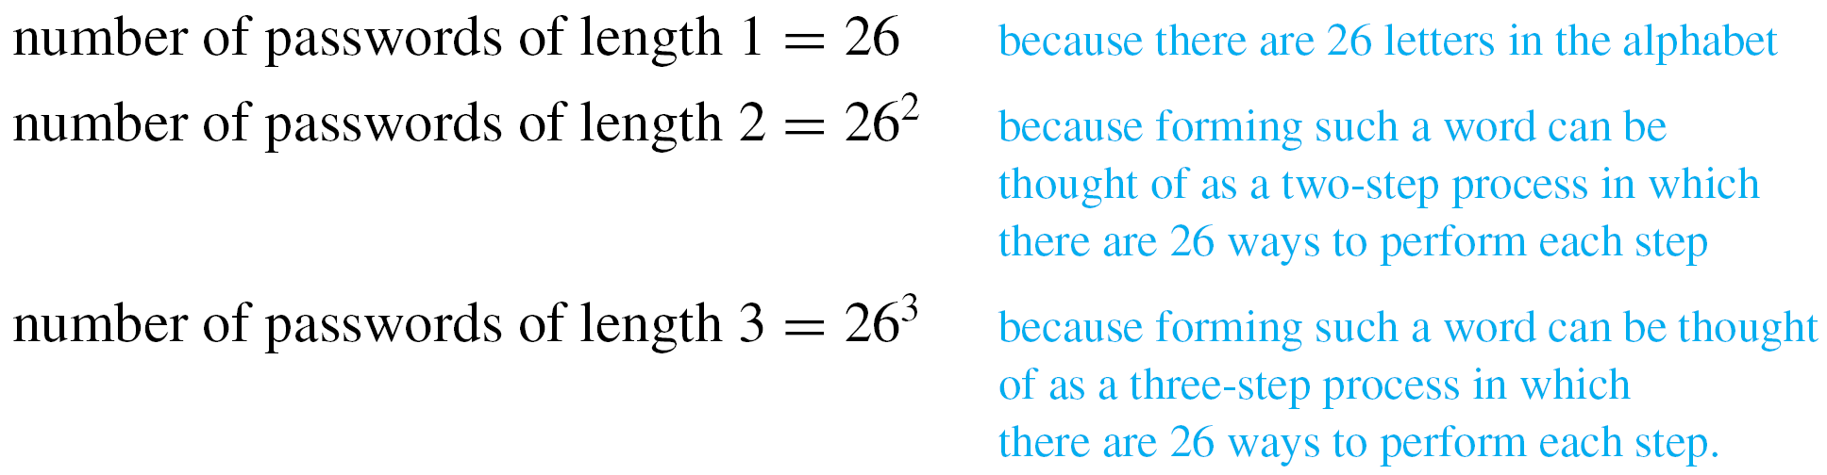
Example 1 – Solution
cont’d
By the addition rule, the total number of passwords equals
the number of passwords of length 1, plus the number of
passwords of length 2, plus the number of passwords of
length 3.
Now the

Slide 6
Example 1 – Solution
cont’d
Hence the total number of passwords = 26 + 26² + 26³
= 18,278.

Slide 7
The Difference Rule

Slide 8
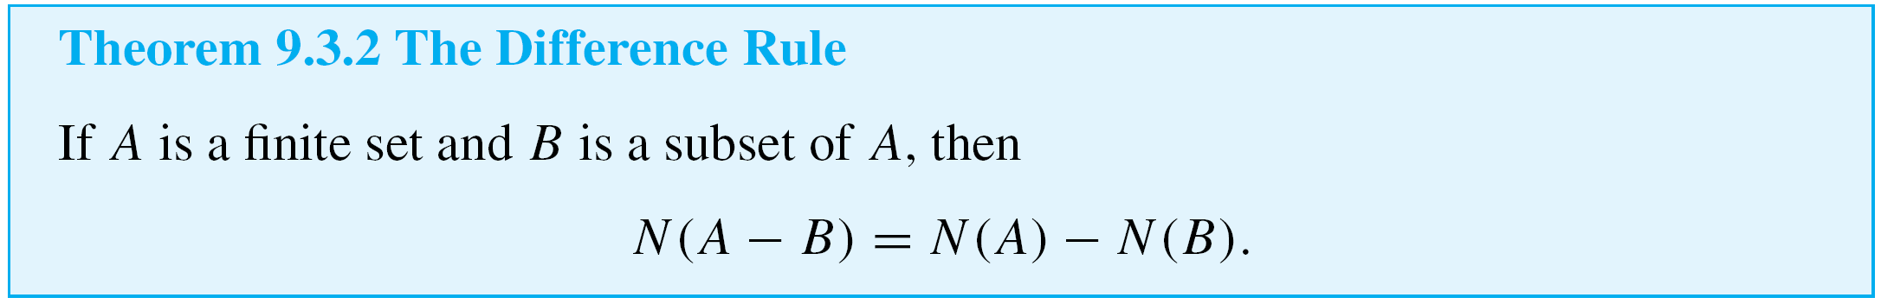
The Difference Rule
An important consequence of the addition rule is the fact that if the number of elements in a set A and the number in a subset B of A are both known, then the number of elements that are in A and not in B can be computed.

Slide 9
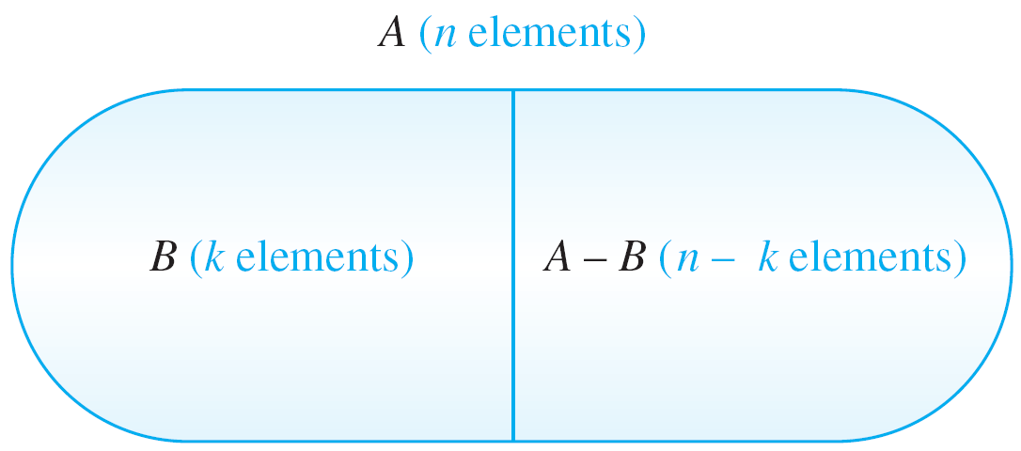
The Difference Rule
The difference rule is illustrated in Figure 9.3.3.
The Difference Rule
Figure 9.3.3

Slide 10
The Difference Rule
The difference rule holds for the following reason: If B is a subset of A, then the two sets B and A – B have no elements in common and B ∪ (A – B) = A. Hence, by the addition rule,
N(B) + N(A – B) = N(A).
Subtracting N(B) from both sides gives the equation
N(A – B) = N(A) – N(B).

Slide 11
Example 3 – Counting PINs with Repeated Symbols
A typical PIN (personal identification number) is a sequence of any four symbols chosen from the 26 letters in the alphabet and the ten digits, with repetition allowed.
a. How many PINs contain repeated symbols?
b. If all PINs are equally likely, what is the probability that a
randomly chosen PIN contains a repeated symbol?

Slide 12
Example 3(a) – Solution
There are 36⁴ = 1,679,616 PINs when repetition is allowed, and there are 36  35  34  33 = 1,413,720 PINs when repetition is not allowed.
Thus, by the difference rule, there are
1,679,616 – 1,413,720 = 265,896
PINs that contain at least one repeated symbol.

Slide 13
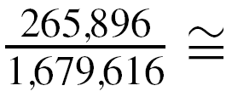

Example 3(b) – Solution
cont’d
There are 1,679,616 PINs in all, and by part (a) 265,896 of these contain at least one repeated symbol.
Thus, by the equally likely probability formula, the probability that a randomly chosen PIN contains a repeated
symbol is

Slide 14
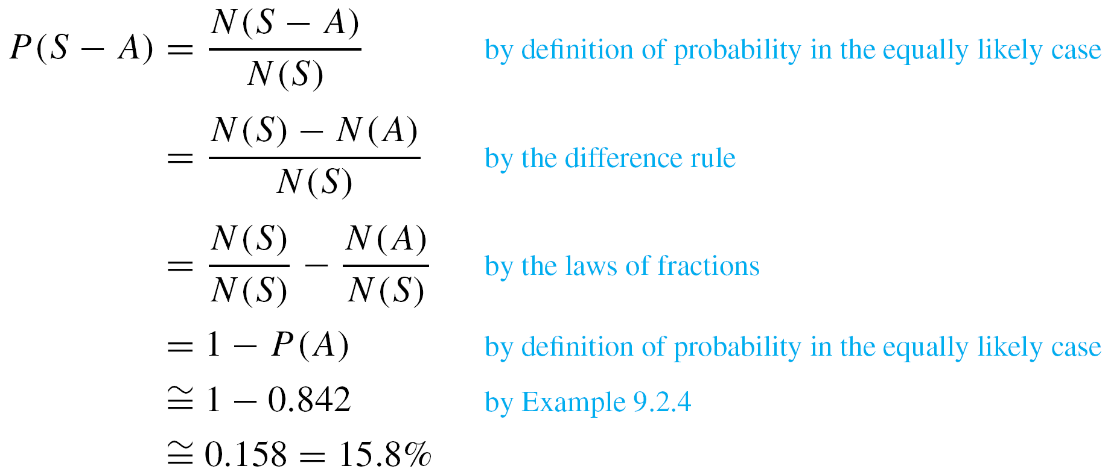
The Difference Rule
An alternative solution to Example 3(b) is based on the observation that if S is the set of all PINs and A is the set of all PINs with no repeated symbol, then S – A is the set of all PINs with at least one repeated symbol.
It follows that

Slide 15

The Difference Rule
We know that the probability that a PIN chosen at random
contains no repeated symbol is P(A) = .
And hence

Slide 16
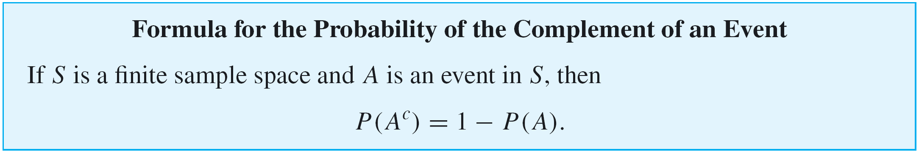
The Difference Rule
This solution illustrates a more general property of probabilities: that the probability of the complement of an event is obtained by subtracting the probability of the event from the number 1.

Slide 17
The Inclusion/Exclusion Rule

Slide 18
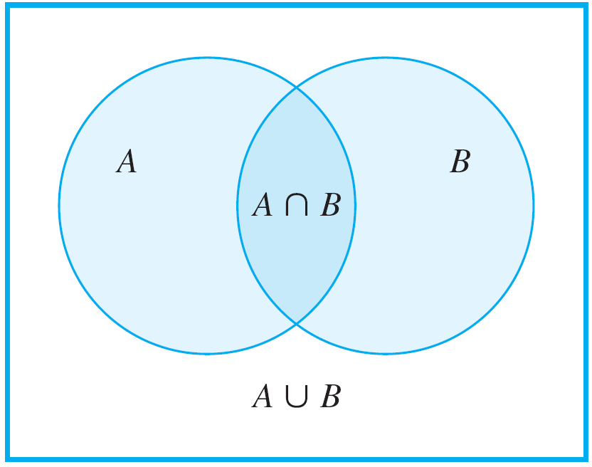
The Inclusion/Exclusion Rule
The addition rule says how many elements are in a union of sets if the sets are mutually disjoint. Now consider the question of how to determine the number of elements in a union of sets when some of the sets overlap.
For simplicity, begin by looking at a union of two sets A and B, as shown in Figure 9.3.5.
Figure 9.3.5

Slide 19
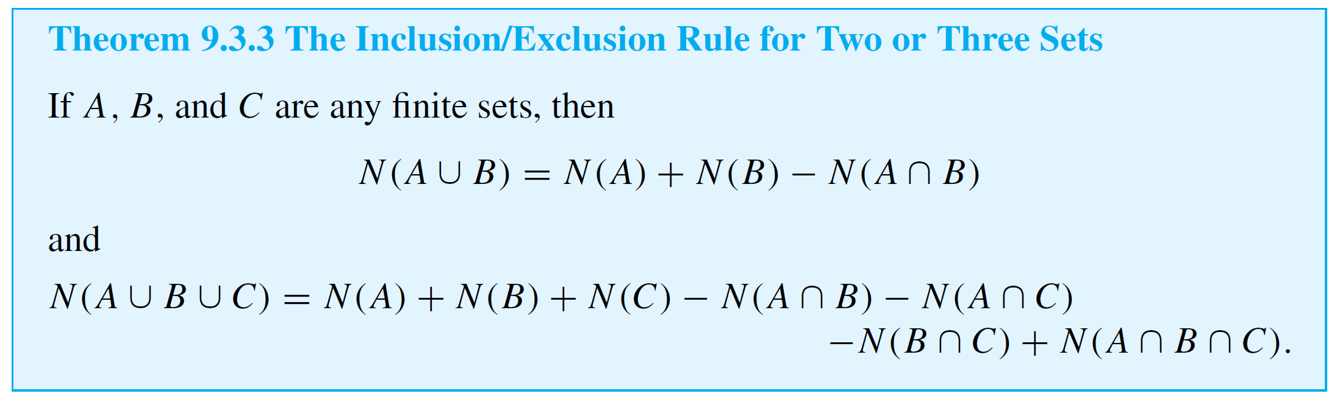
The Inclusion/Exclusion Rule
To get an accurate count of the elements in A ∪ B, it is necessary to subtract the number of elements that are in both A and B. Because these are the elements in A ∩ B,
A similar analysis gives a formula for the number of elements in a union of three sets, as shown in Theorem 9.3.3.

Slide 20
Example 6 – Counting Elements of a General Union
a. How many integers from 1 through 1,000 are multiples of
3 or multiples of 5?
b. How many integers from 1 through 1,000 are neither
multiples of 3 nor multiples of 5?
Solution:
a. Let A = the set of all integers from 1 through 1,000 that
are multiples of 3.
Let B = the set of all integers from 1 through 1,000 that
are multiples of 5.

Slide 21
Example 6 – Solution
cont’d
Then
A ∪ B = the set of all integers from 1 through 1,000 that
are multiples of 3 or multiples of 5
and
A ∩ B = the set of all integers from 1 through 1,000 that
are multiples of both 3 and 5
= the set of all integers from 1 through 1,000 that
are multiples of 15.

Slide 22
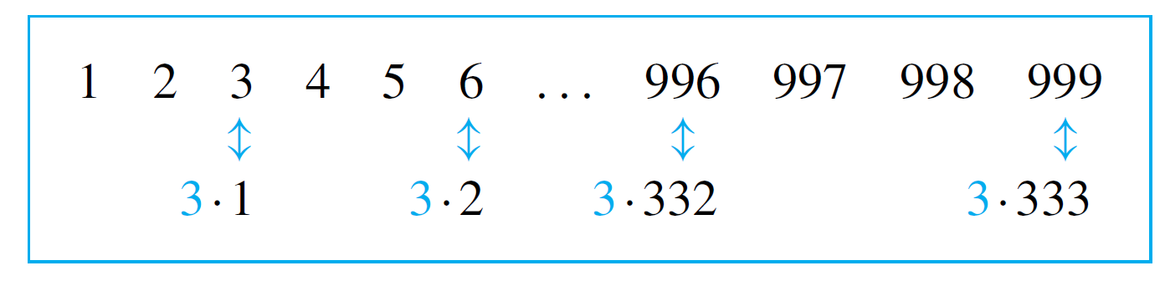
Example 6 – Solution
cont’d
Because every third integer from 3 through 999 is a multiple of 3, each can be represented in the form 3k, for some integer k from 1 through 333.
Hence there are 333 multiples of 3 from 1 through 1,000, and so N(A) = 333.

Slide 23
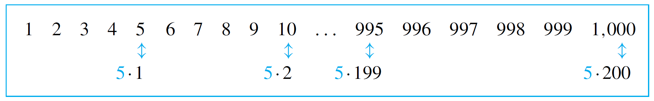
Example 6 – Solution
cont’d
Similarly, each multiple of 5 from 1 through 1,000 has the form 5k, for some integer k from 1 through 200.
Thus there are 200 multiples of 5 from 1 through 1,000 and N(B) = 200.

Slide 24
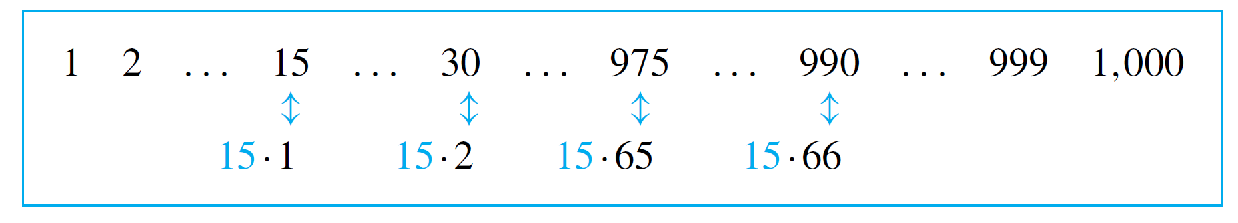
Example 6 – Solution
cont’d
Finally, each multiple of 15 from 1 through 1,000 has the form 15k, for some integer k from 1 through 66 (since 990 = 66  15).
Hence there are 66 multiples of 15 from 1 through 1,000, and N(A ∩ B) = 66.

Slide 25


Example 6 – Solution
cont’d
It follows by the inclusion/exclusion rule that
Thus, 467 integers from 1 through 1,000 are multiples of 3 or multiples of 5.

Slide 26
Example 6 – Solution
cont’d
b. There are 1,000 integers from 1 through 1,000, and by part (a), 467 of these are multiples of 3 or multiples of 5.
Thus, by the set difference rule, there are 1,000 – 467 = 533 that are neither multiples of 3 nor multiples of 5.

Slide 27
The Inclusion/Exclusion Rule
Note that the solution to part (b) of Example 6 hid a use of De Morgan’s law.
The number of elements that are neither in A nor in B is N(A^{c} ∩ B^{c}), and by De Morgan’s law, A^{c} ∩ B^{c} = (A ∪ B)^{c}.
So N((A ∪ B)^{c}) was then calculated using the set difference rule: N((A ∪ B)^{c}) = N(U) – N(A ∪ B), where the universe U was the set of all integers from 1 through 1,000.

